Slide 1

Reddit Sarcasm Prediction
Presented By:
Mayankkumar Patel
Jasleen Kaur
Komal Astawala
Shree Prada
Bhavneet Kaur
Simran

Slide 2
Content
Git walkthrough
Model development
Model tuning
Model deployment – Flask
Demo : Custom UI
Final Results
Project Pitch
Learnings
Target Audience

Slide 3
Git Walkthrough
This project is hosted on GitHub and can be accessed via the following link: https://github.com/shree-prada/Reddit-Sarcasm-Prediction
The repository contains the code, dataset, and documentation related to the Reddit Comment Sarcasm Prediction project.
Key directories include:
-Flask/- custom ui files
-fore.pkl – model deployment file

Slide 4
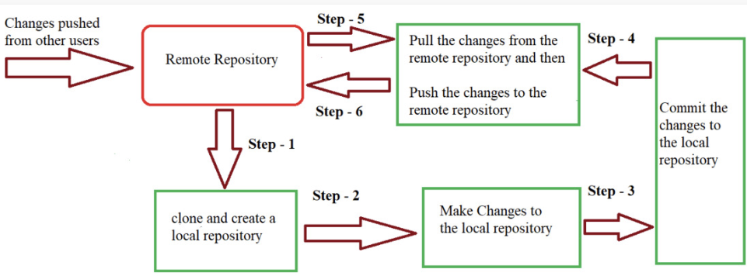
Git Flow

Slide 5
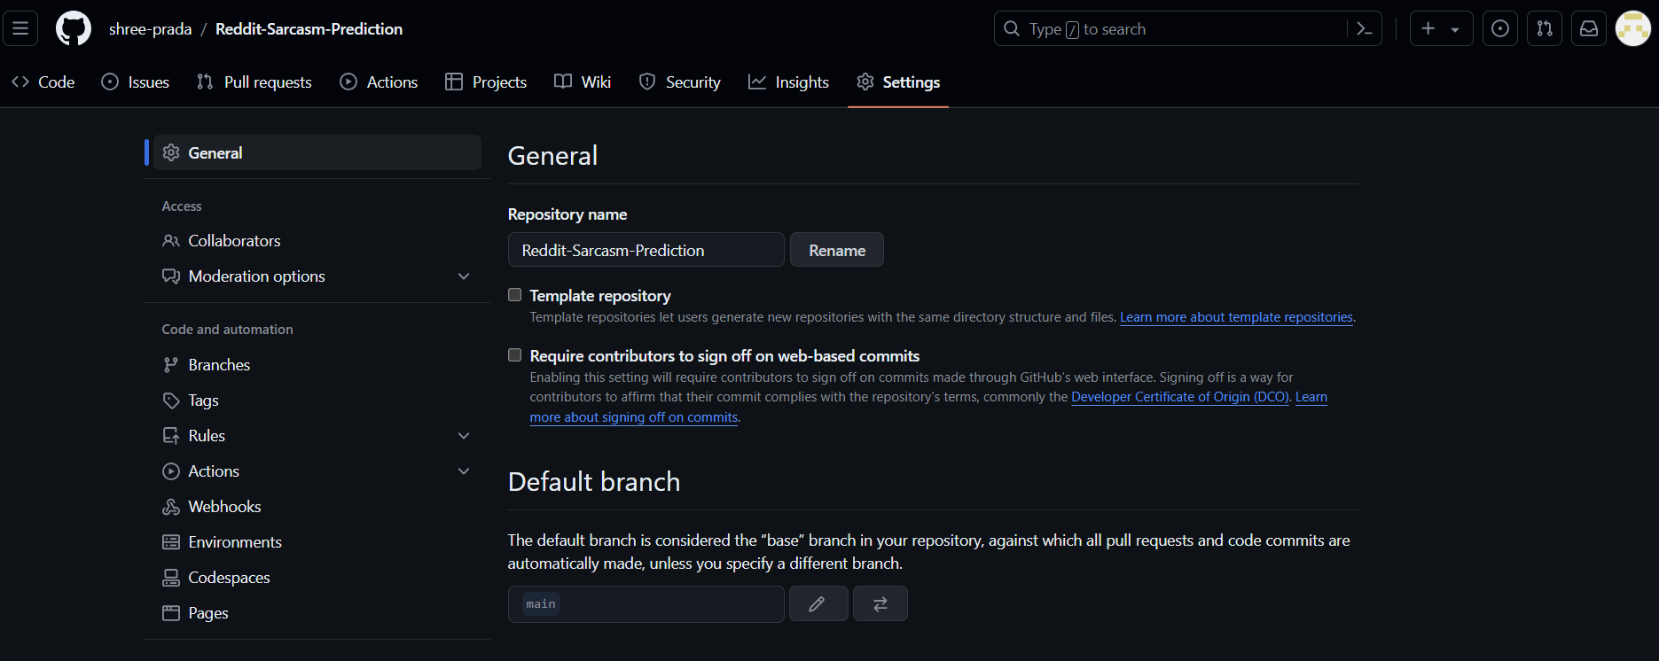
Remote Repository

Slide 6
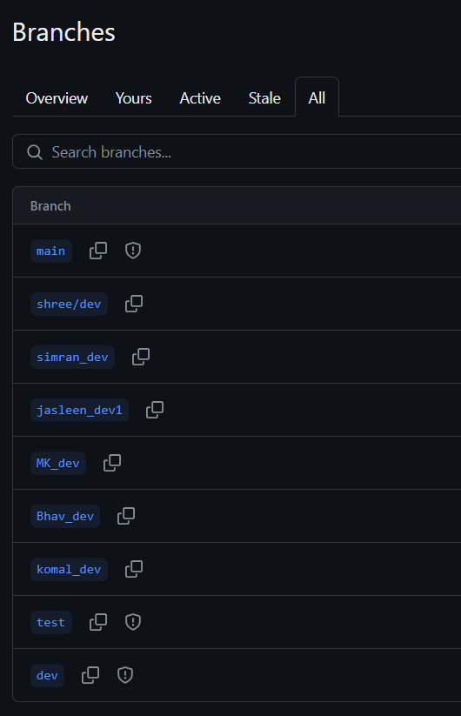
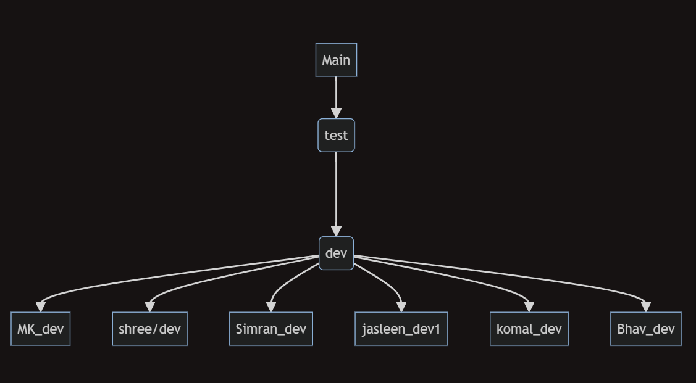
Git Branches

Slide 7
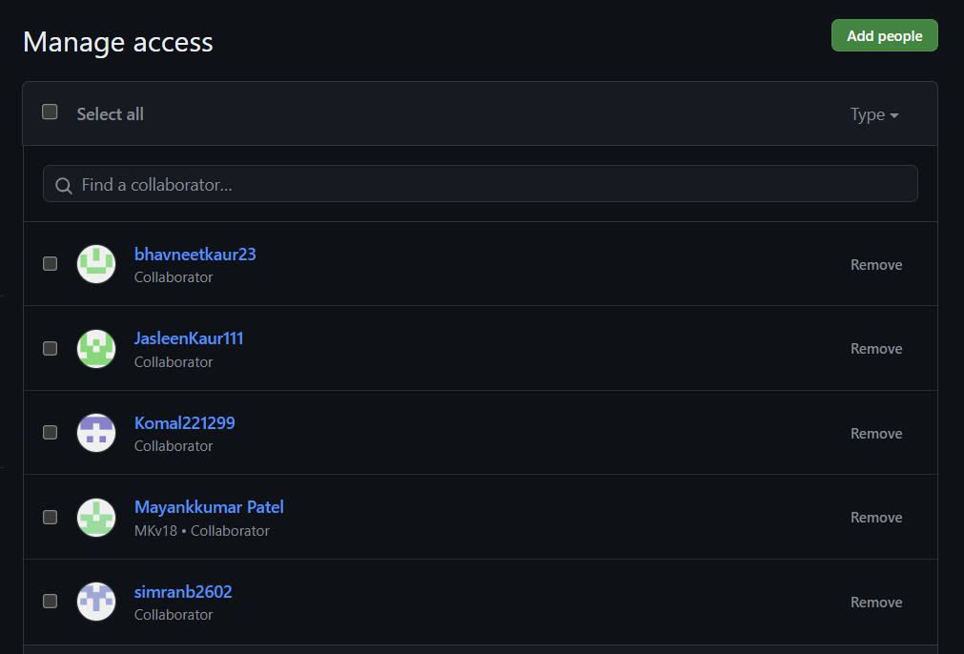
Collaborators

Slide 8
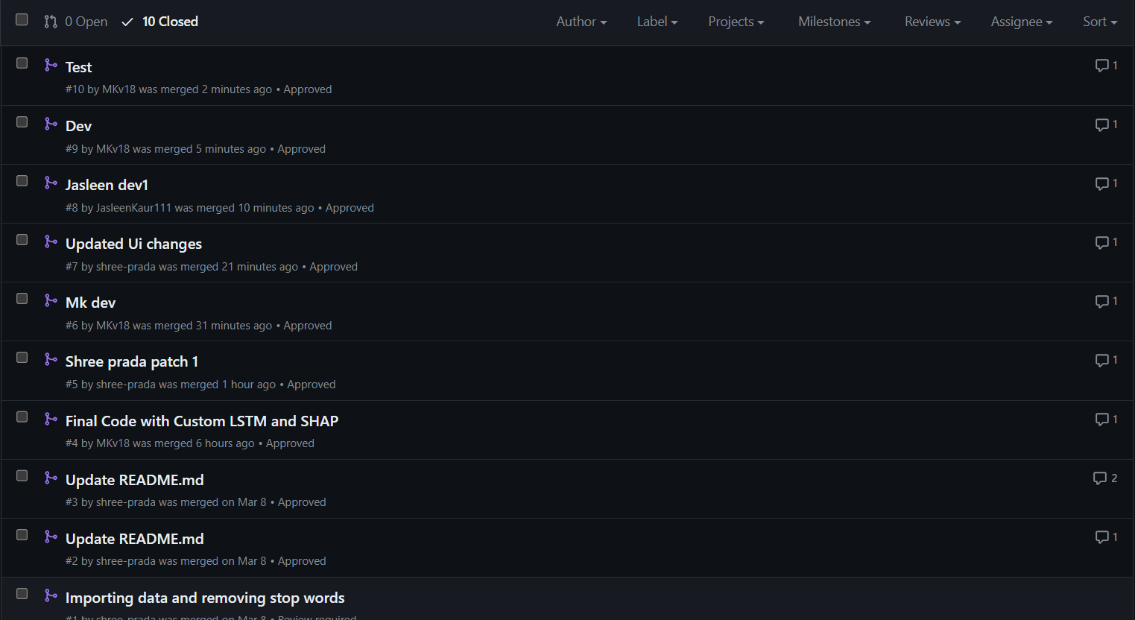
Pull Requests and Review comments
We utilize Git's pull request feature for proposing and reviewing code changes. This ensures that all contributions undergo thorough review before integration into the main codebase.

Slide 9
Model development
Our sarcasm prediction model leverages a Long Short-Term Memory (LSTM) neural network architecture.
Data preprocessing involves:
Text cleaning: Punctuation, special characters, Emoji handling, Replacing Abbreviations etc.
Tokenization: Breaking text into individual words or phrases.
Stop word removal: Eliminating common words that carry little meaning.
Lemmatization: Reducing words to their base or dictionary form.
The LSTM model is trained on a labeled dataset consisting of sarcastic and non-sarcastic Reddit comments.
We utilize word embeddings to represent textual data, capturing semantic relationships between words.

Slide 10
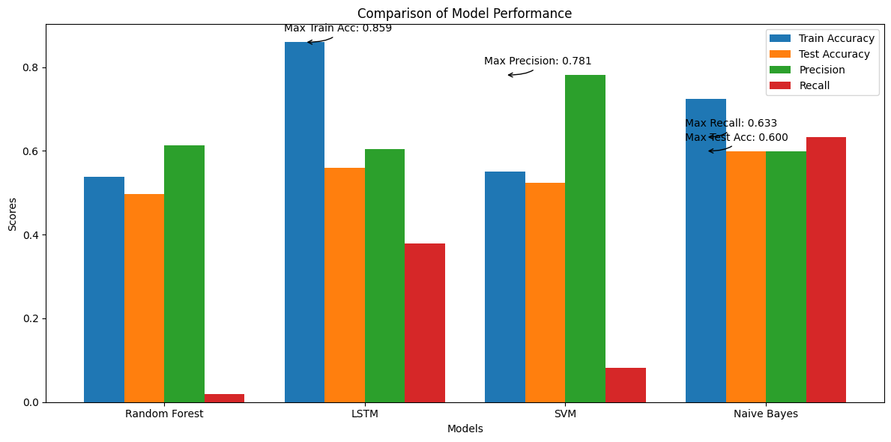
Comparison of all the tried models
Comparison for 10k records(5k sarcastic, 5k non sarcastic)

Slide 11
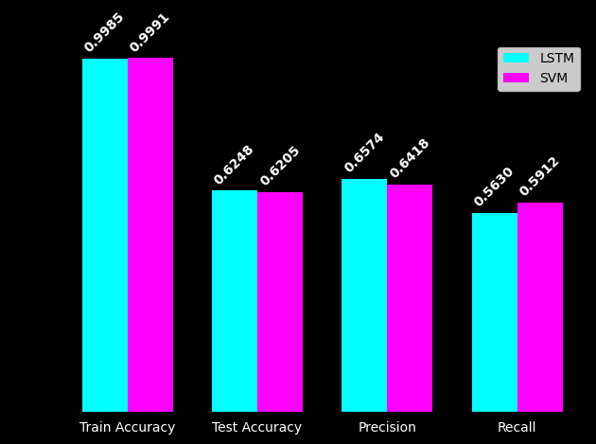
Comparison between Custom LSTM and Custom LSTM based SVM
20k records(10k sarcastic, 10k Non sarcastic)

Slide 12
Model tuning
Custom LSTM Model
In order to apply GridSearch cross validation for different number of epochs we have made our own custom LSTM classifier estimator and ran our model with 20 and 50 epochs in order to find the best parameters.
We have used 5 fold cross validation
Custom LSTM based SVM
In order to apply GridSearch cross validation for parameters c, Gamma, and Kernel to find the best parameters.
We have used 5 fold cross validation

Slide 13
Model Evaluation
The efficacy of the sarcasm prediction model is gauged through diverse metrics, including accuracy, precision, recall, and F1 score. Key metrics include:
Best LSTM Accuracy on Training Set: 0.998875
Best LSTM Accuracy on Test Set: 0.629
Precision: 0.6458865610628512
Recall: 0.6150851581508516
F1-score: 0.6301096709870389
Confusion Matrix: [[1252 693] [ 791 1264]]

Slide 14
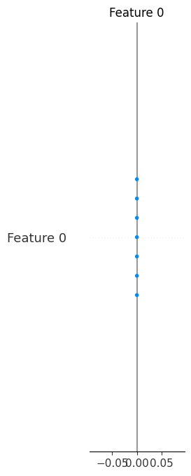
Model Interpretability
We have used SHAP instead of LIME as a generalized framework for interpretation of complex models like LSTM

Slide 15
Model deployment - Flask
The NLP model is deployed using Flask, a lightweight web framework for Python.
Flask provides an API endpoint for interacting with the model.
We encapsulate the model prediction logic within Flask routes, allowing users to input text and receive sarcasm predictions in real-time.

Slide 16
Demo : Custom UI
Our project features a custom user interface (UI) for easy interaction with the sarcasm prediction model.
Users can input Reddit comments via a text box and receive instant predictions on their sarcasm.
The UI provides a seamless and intuitive experience, enhancing accessibility for users.

Slide 17
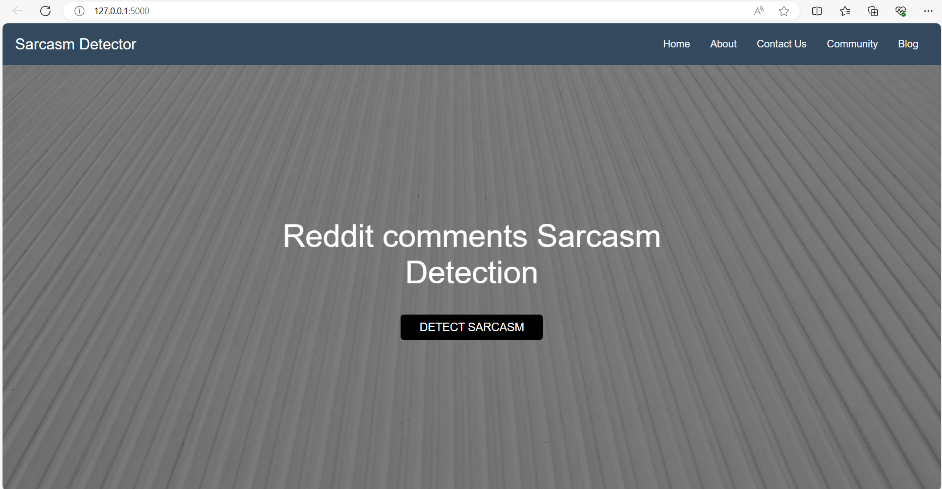

Slide 18
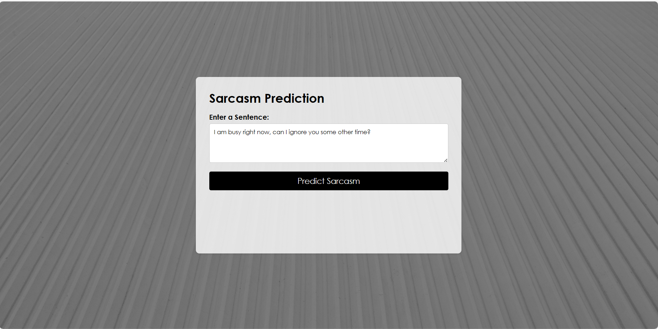

Slide 19
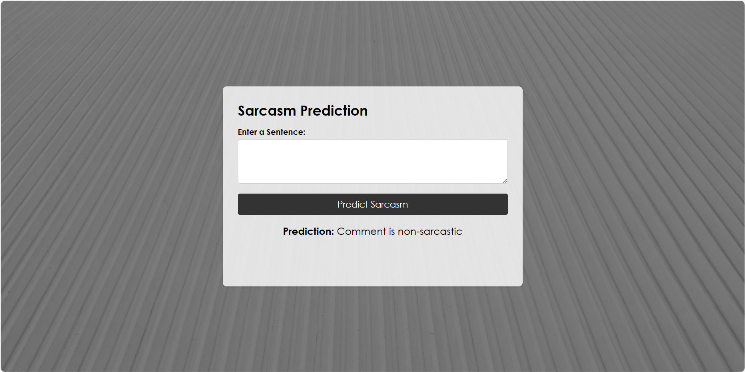

Slide 20
Project Pitch
Our project aims to address the challenge of sarcasm detection in online conversations, a crucial task in sentiment analysis and social media monitoring.
By accurately predicting sarcasm, our model can aid in sentiment analysis, content moderation, and brand reputation management.
Potential applications include:
Social media analytics tools
Customer feedback analysis platforms
Online community moderation systems

Slide 21
Learnings
Key learnings from the project include:
Deepening understanding of NLP techniques and methodologies.
Gaining practical experience in model development, tuning, and deployment.
Overcoming challenges in data preprocessing, training, and evaluation.
Insights gained contribute to the continuous improvement and innovation in NLP research and application.

Slide 22
Target Audience
Our project caters to a diverse audience including:
Data scientists and NLP researchers interested in sarcasm detection and sentiment analysis.
Social media platform developers seeking to enhance content moderation algorithms.
Marketing professionals aiming to gauge audience sentiment and engagement on digital platforms.

Slide 23

Thank you

